Slide 1
Amazon SimpleDB
is a highly available, scalable, and flexible non-relational data store that enables you to store and query data items using web services requests.
Requires no schema, automatically indexes the data.
Provides the ability to store, process, and query data sets in the cloud.
No need to install and administer the database.
Requires no license.
Works closely with Amazon S3 and Amazon EC2.
Provides simple API for storage and access of data
Amazon SimpleDB is a web service for running queries on structured data in real time.

Slide 2
Simple DB in a Nutshell
Simple DB Domain
Idea:
Create flat database with
auto-indexed tables.
Record 1
Key1
Attributes: A1,A2…
…
Record N
Main Features:
Each attribute is indexed.
Record structure is flexible.
Basic operators in queries
Supports sorting.
Key2
Attributes: A1,A2…
Get record
Query records
Put record
Client

Slide 3
SimpleDB data model details
• Domains
identified by a string (UTF-8)
100/account (beta)
10 GB/domain (beta)
Items
identified by a string (UTF-8)
unlimited number/domain
Attributes
name-value pair (both UTF-8)
type-less values, just strings; automatically indexed
256/item
250 mio./domain
1KB/attribute value

Slide 4
SimpleDB operations
Domains
CreateDomain
ListDomains
DeleteDomain
tems/Attributes
PutAttributes (store/change an item)
DeleteAttributes
GetAttributes (retrieve an item)
What is Missing?
No transaction, No notifications, No joins, No data types

Slide 5
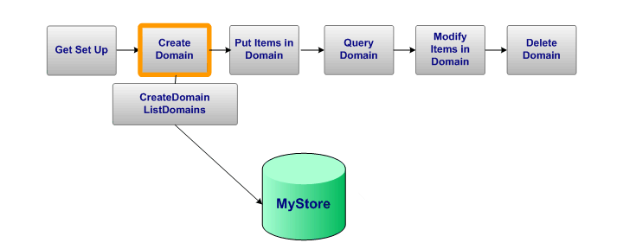
SimpleDB: Create Domain

Slide 6
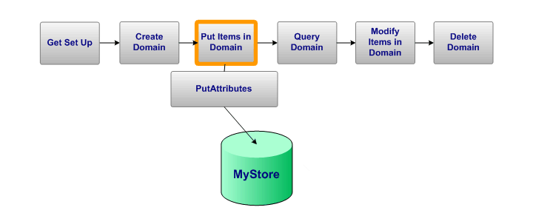
SimpleDB: Put Item in Domain

Slide 7
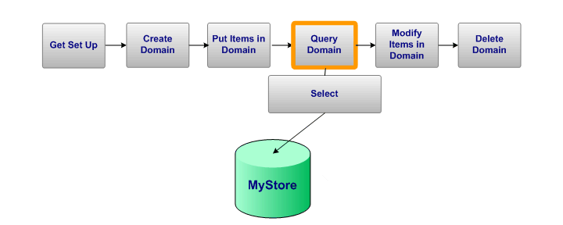
SimpleDB: Query Domain

Slide 8
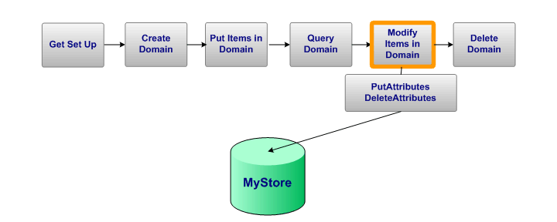
SimpleDB: Modify Items in Domain

Slide 9
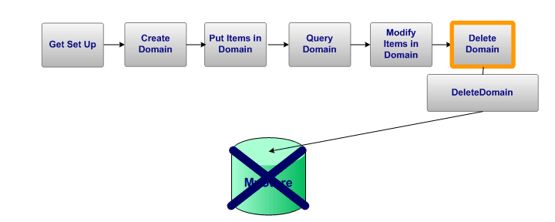
SimpleDB: Delete Domain

